Slide 1
Revision Strategies

Slide 2
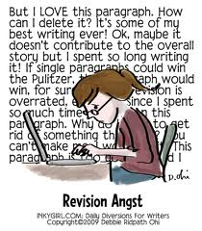
Revision is like a deep-tissue massage; it hurts so good!

Slide 3
Revision vs Editing
Editing:
  Correcting for grammatical mistakes
Revision:
  Correcting for clarity and quality of writing
  There may be nothing “wrong”
    might not be the best choice or time
  Ask yourself: “Am I accomplishing what I want to accomplish here? Is this as good I can make it?”
  (Hint: The answer is nearly always “no”)
    Nothing is ever done, it’s just due.

Slide 4
If a teacher told me to revise, I thought that meant my writing was a broken-down car that needed to go to the repair shop. I felt insulted. I didn't realize the teacher was saying, "Make it shine. It's worth it." Now I see revision as a beautiful word of hope. It's a new vision of something. It means you don't have to be perfect the first time. What a relief!
Naomi Shihab Nye

Slide 5
Making you into a writing S.T.A.R.
Four main methods to use in revision:
  Substitute
  Take out
  Add
  Rearrange

Slide 6
Substitution
Ask yourself:
  Is the image clear?
  Is the word specific?
  The right connotative meaning?
  A better synonym?

Slide 7
Take Out
One of the hardest things to do for a writer
Ask yourself:
  Am I moving my story or argument forward?
  Does it help me prove my point?
  Is it adding to the message/mood?
  Is it critical for understanding?
  Am I being redundant?

Slide 8
Add
Ask yourself
  Do I need to give a clearer explanation?
  Should I add more detail?
  Am I moving too quickly?
  Do I have more (important) things to say?

Slide 9
Rearrange
Often times, you’ll find something written in a third or fourth paragraph may be better in the first.
Ask yourself
  Would this work better elsewhere?
  Why do I include this here?
  Does this information need to be discussed earlier?
  Could moving this add foreshadowing, suspense, or tension?
  Are my ideas following a logical order?
  Are my ideas in chronological order? Is this the best choice?

Slide 10
The Results
With each revision your writing should improve.
There’s clear evidence that revision helps in essay scores from past classes

Slide 11
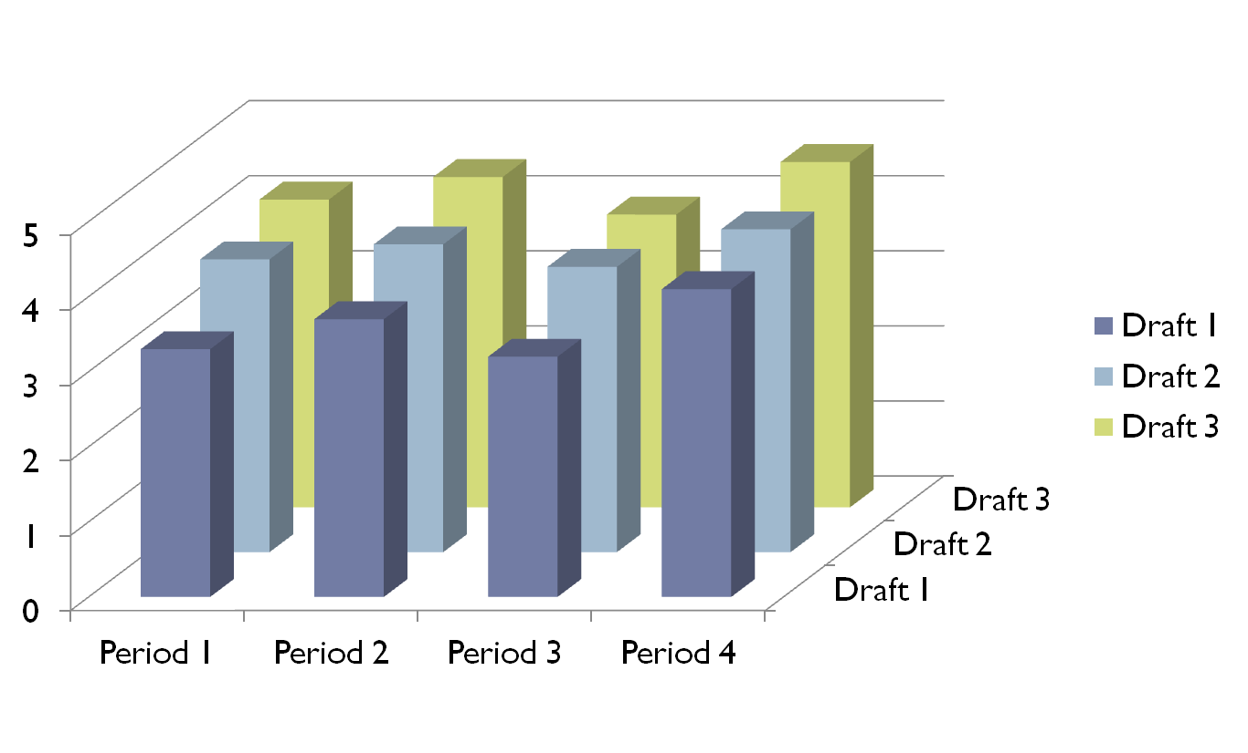
SAT rubric scores with revision

Slide 12
Revision should be difficult, it’ll probably be a little painful, but it is a crucial step in becoming a good writer.

Slide 13
"The beautiful part of writing is that you don't have to get it right the first time, unlike, say, a brain surgeon. You can always do it better, find the exact word, the apt phrase, the leaping simile."
Robert Cormier

